Slide 1
TOPICS
Correlation:
Types of analysis:-
Univariate analysis
Bivariate analysis
Multivariate analysis.

Slide 2
The statistical technique that examines the relationship and explains whether, and how strongly, pairs of variables are related to one another is known as correlation.
Correlation answers questions such as
How one variable changes with respect to another. If so to what degree or strength.
How variables change together, both in the same or opposite directions and in the magnitude (that is, strength) of the relationship

Slide 3
The columns of a dataset probably be related to one another because they are collected from the same event.
One field of record may or may not affect the value of another field.
To examine the type of relationships these columns have and to analyze the causes and effects between them we need to find the dependencies that exist among variables.
The strength of such a relationship between two fields of a dataset is called correlation, which is represented by a numerical value between -1 and 1.

Slide 4
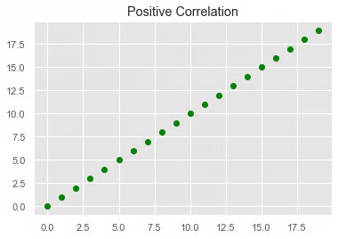
Different types of correlation:
Positive Correlation: Two variables are said to be positively correlated when their values move in the same direction. The value for X increases, so does the value Y at a constant rate.

Slide 5
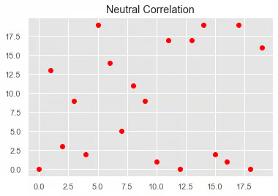
No Correlation: No relationship in the change of variables X and Y. In this case, the values are completely random and do not show any sign of correlation.

Slide 6
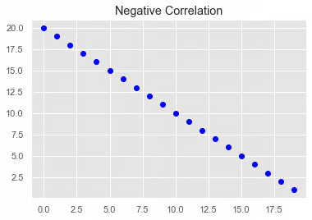
Negative Correlation: X and Y will be negatively correlated when their values change in opposite directions, when the value for X increases, the value for Y decreases at a constant rate.

Slide 7
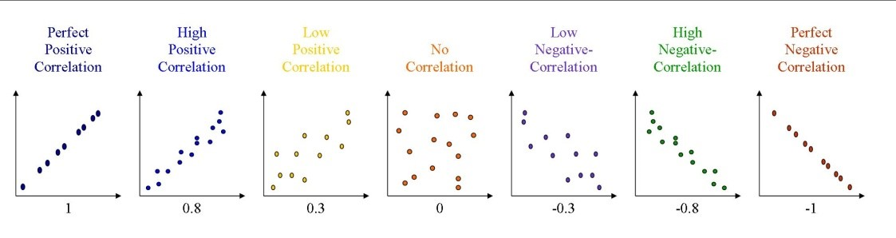

Slide 8
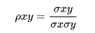
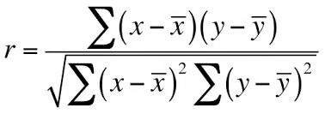
Pearson's correlation coefficient
The Pearson's correlation coefficient (r) is a score that measures the strength of a linear relationship between two variables. It is calculated by dividing the covariance of variables X and Y by the product of the standard deviation of each variable.

Slide 9
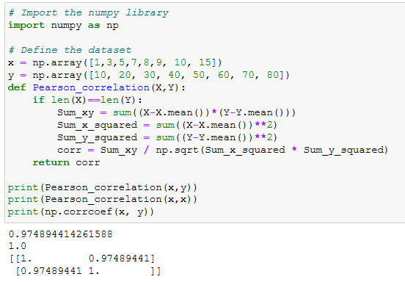

Slide 10
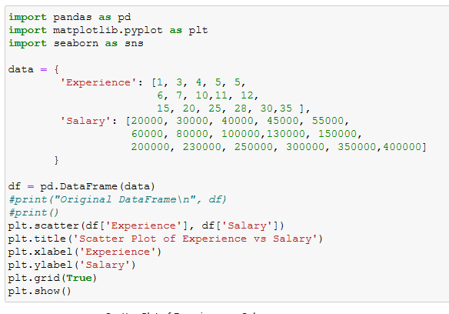

Slide 11
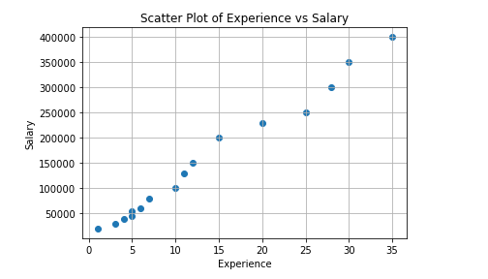
What type of correlation we can infer from above plot
or
Analyze the above plot to identify the type of correlation

Slide 12
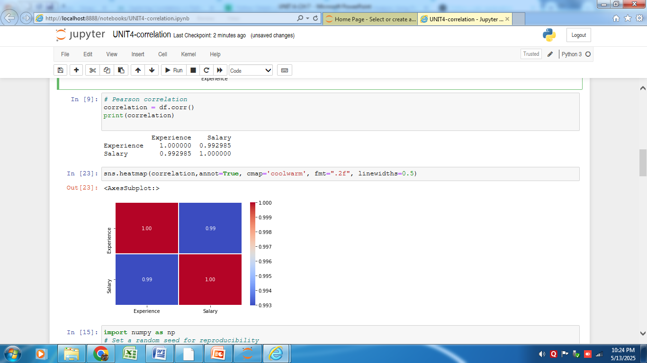

Slide 13
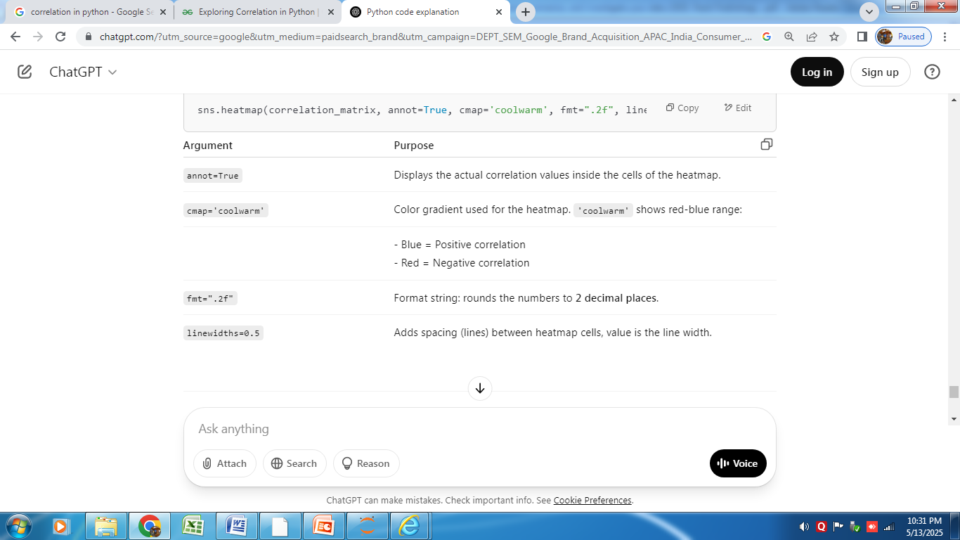
sns.heatmap(correlation_matrix, annot=True, cmap='coolwarm', fmt=".2f", linewidths=0.5)

Slide 14
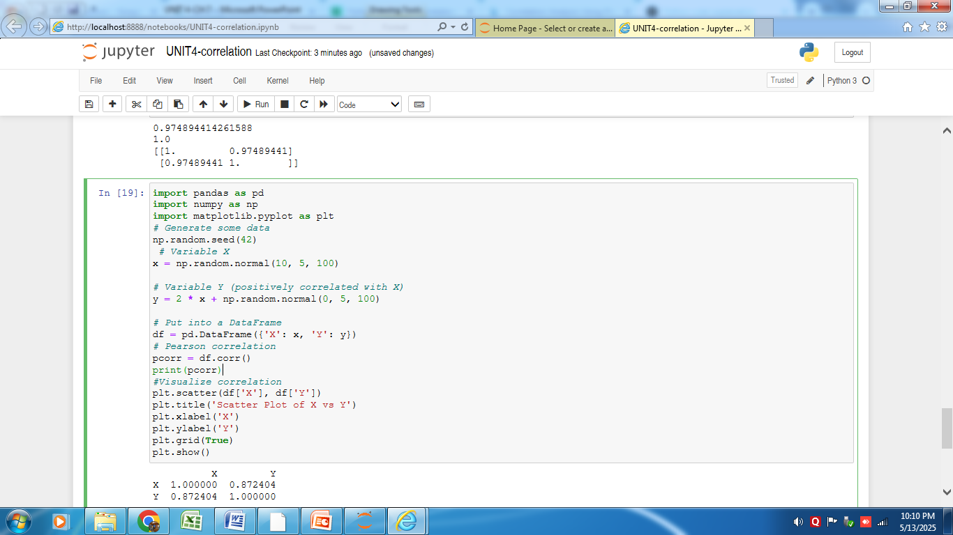

Slide 15
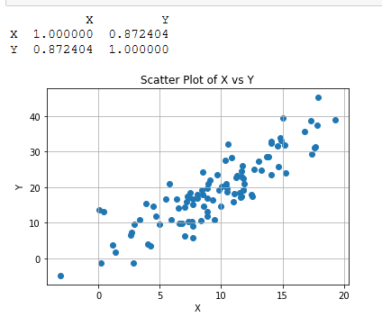

Slide 16
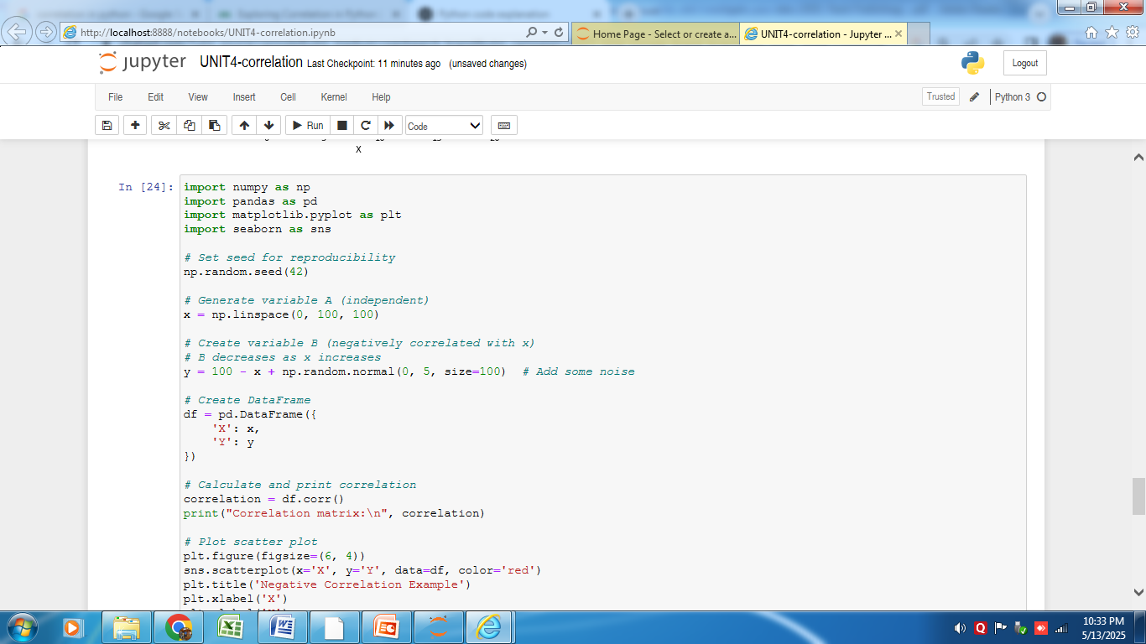
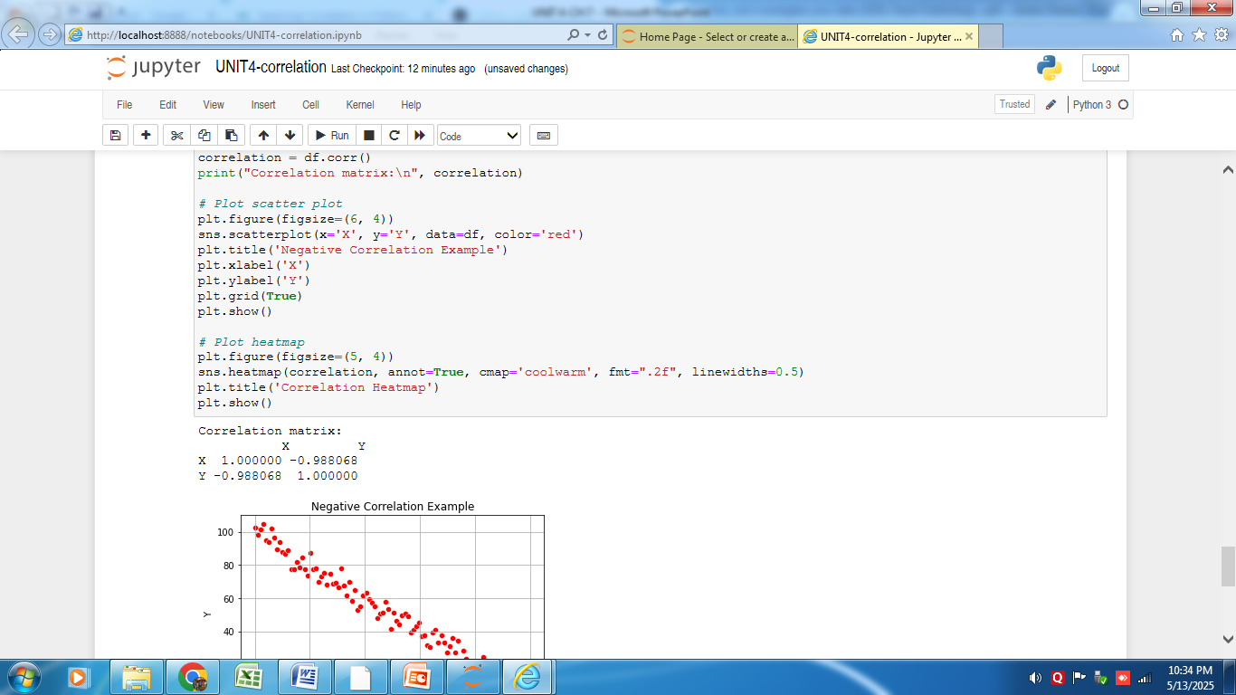

Slide 18
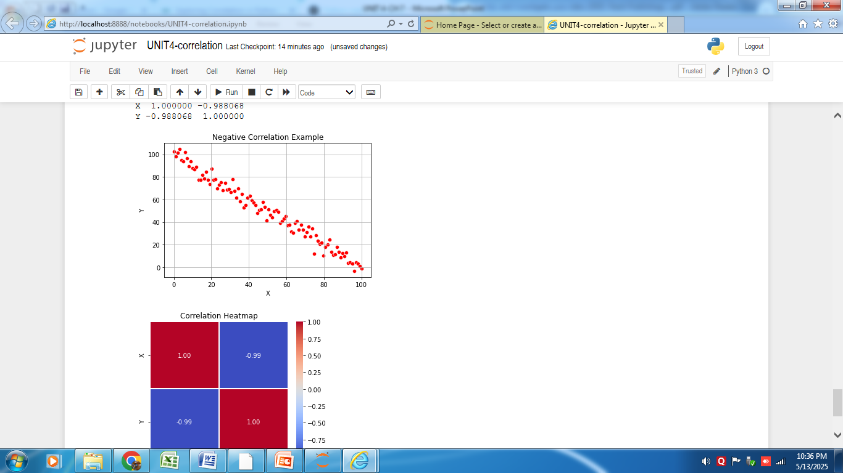
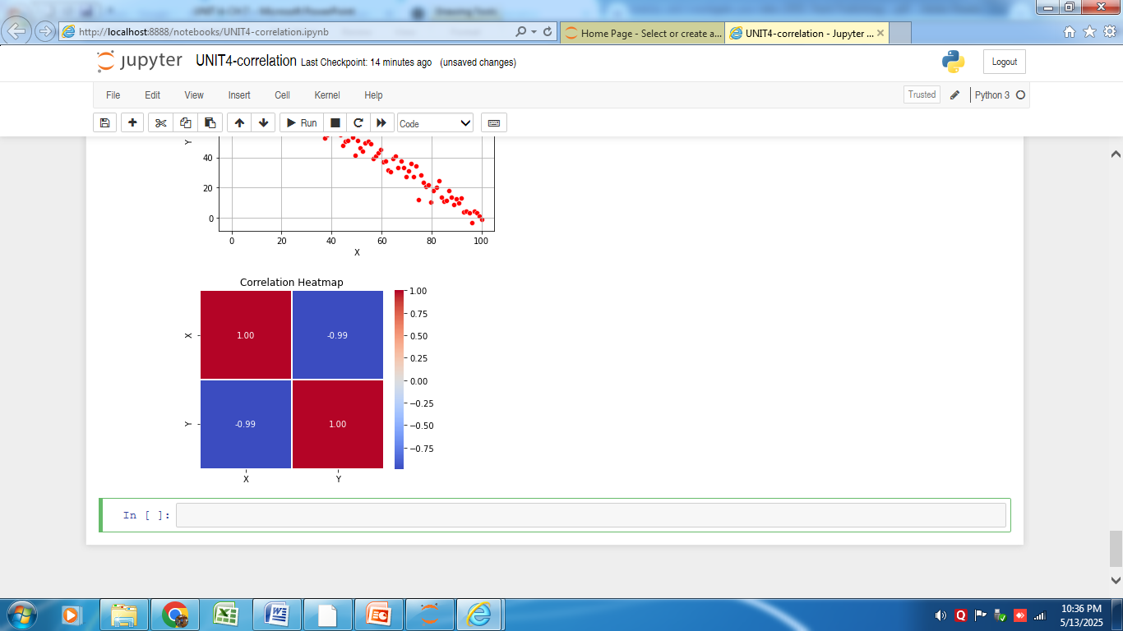

Slide 19
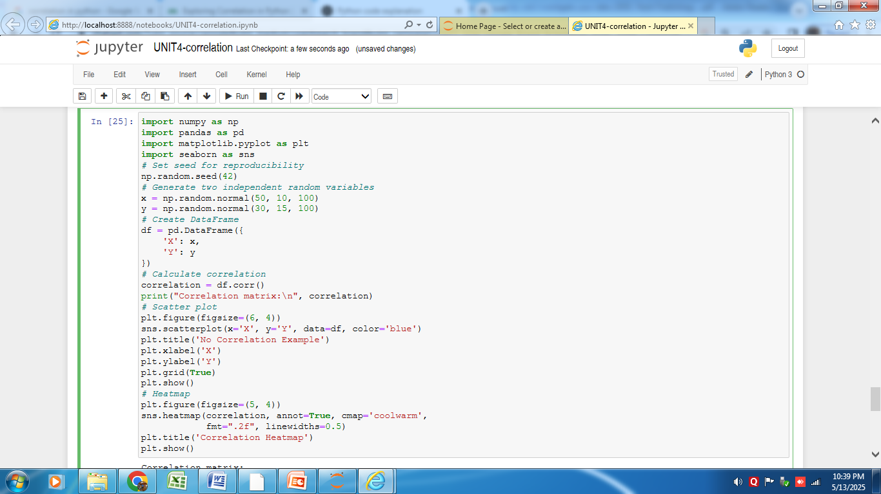

Slide 20
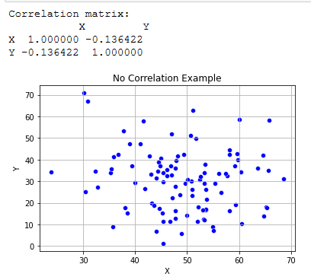

Slide 21
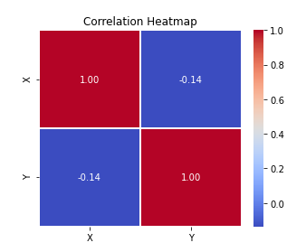
The heatmap confirms with a correlation coefficient near 0

Slide 22
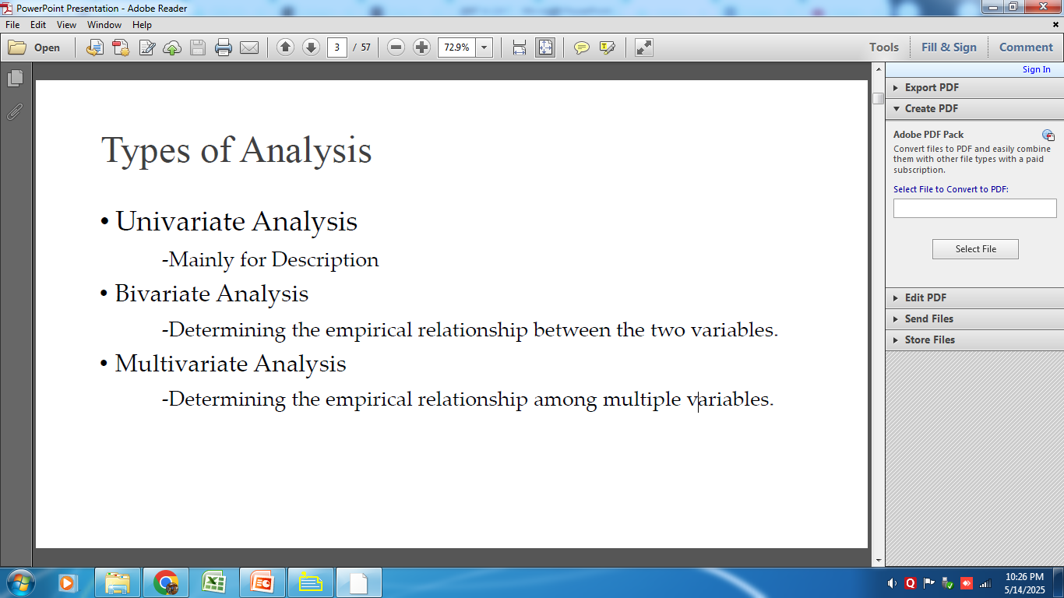

Slide 23
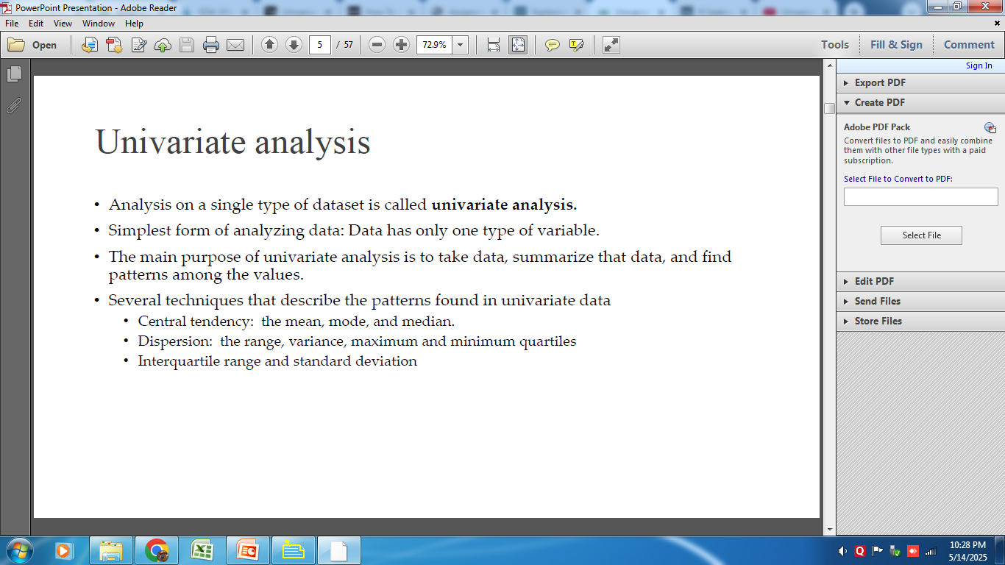

Slide 24
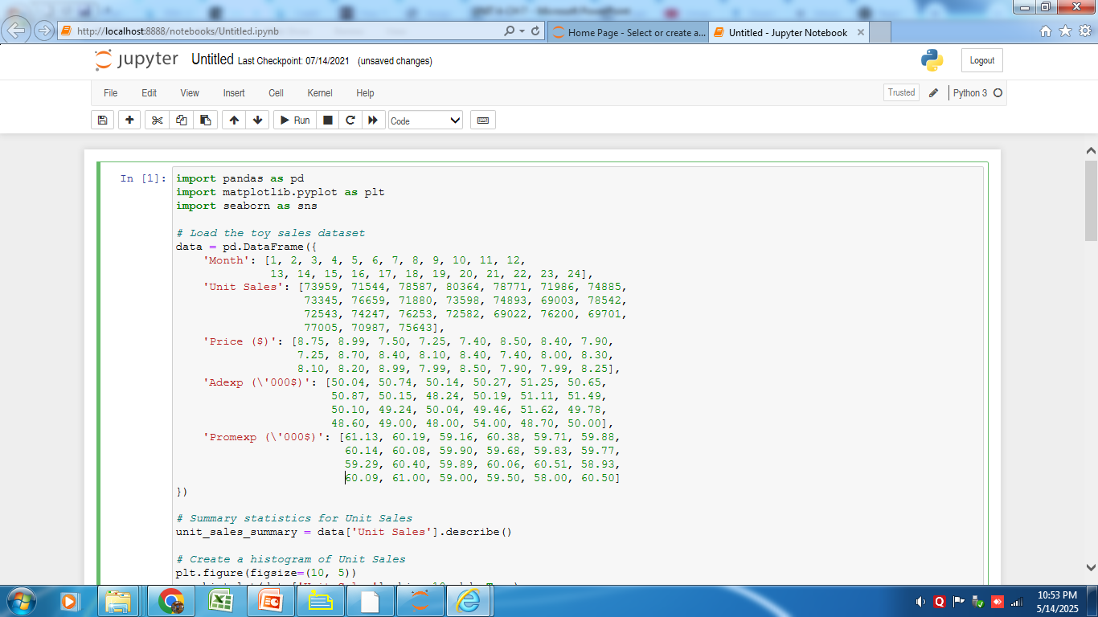

Slide 25
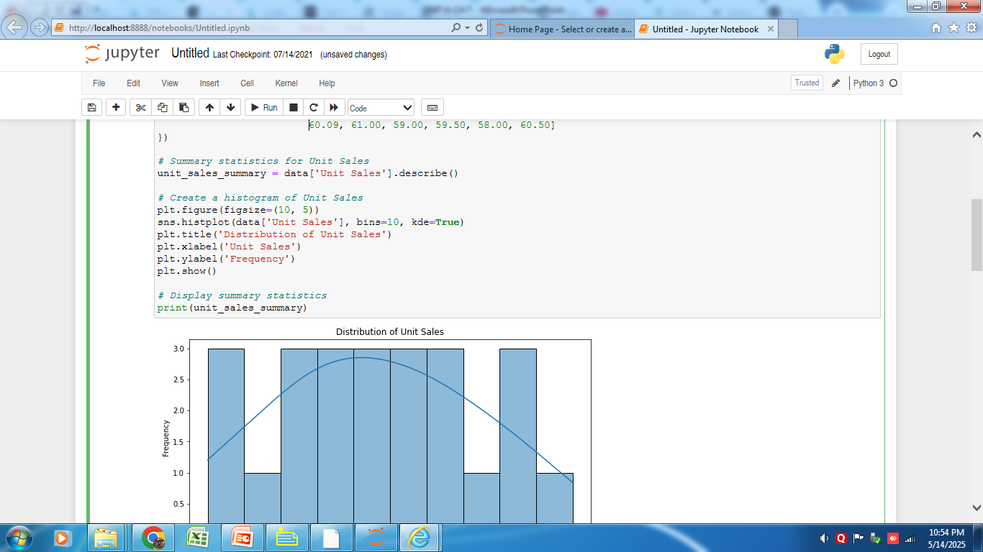

Slide 26
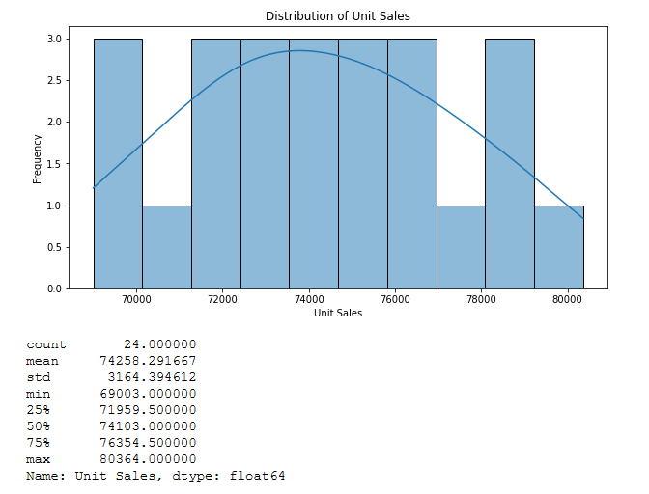

Slide 27
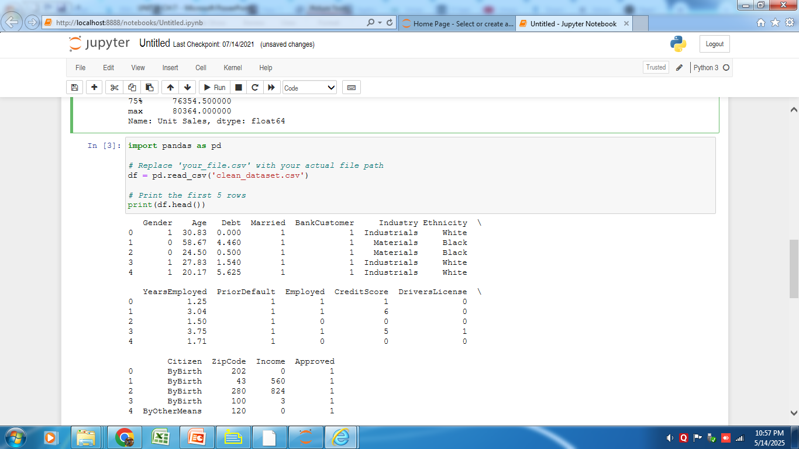

Slide 28
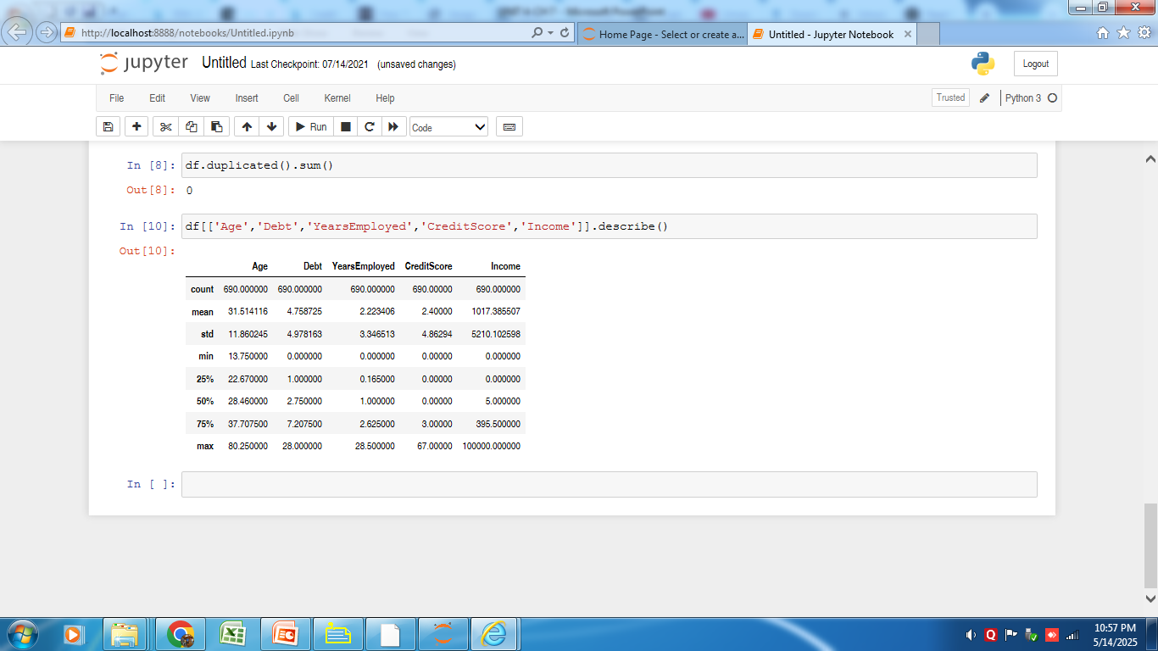
minimum age among the applicants is 13.75.
minimum value of the Years Employed column is 0.
This tells that people without any employment history also applied for a credit card.

Slide 29
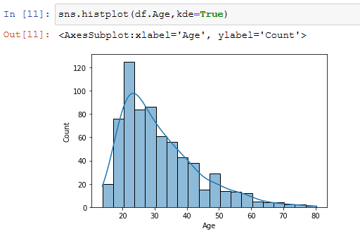
very few people applied for credit cards after turning 50.
people between the ages of 20 and 40 applied the most as compared to other groups. This provides us an insight that people tend to apply for credit cards in the early phase of their lives. Hence, credit card issuing firms can target people in the age group 20–40.

Slide 30
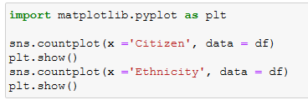
Univariate analysis of categorical data. We’ll be using the count plot function from the seaborn library

Slide 31
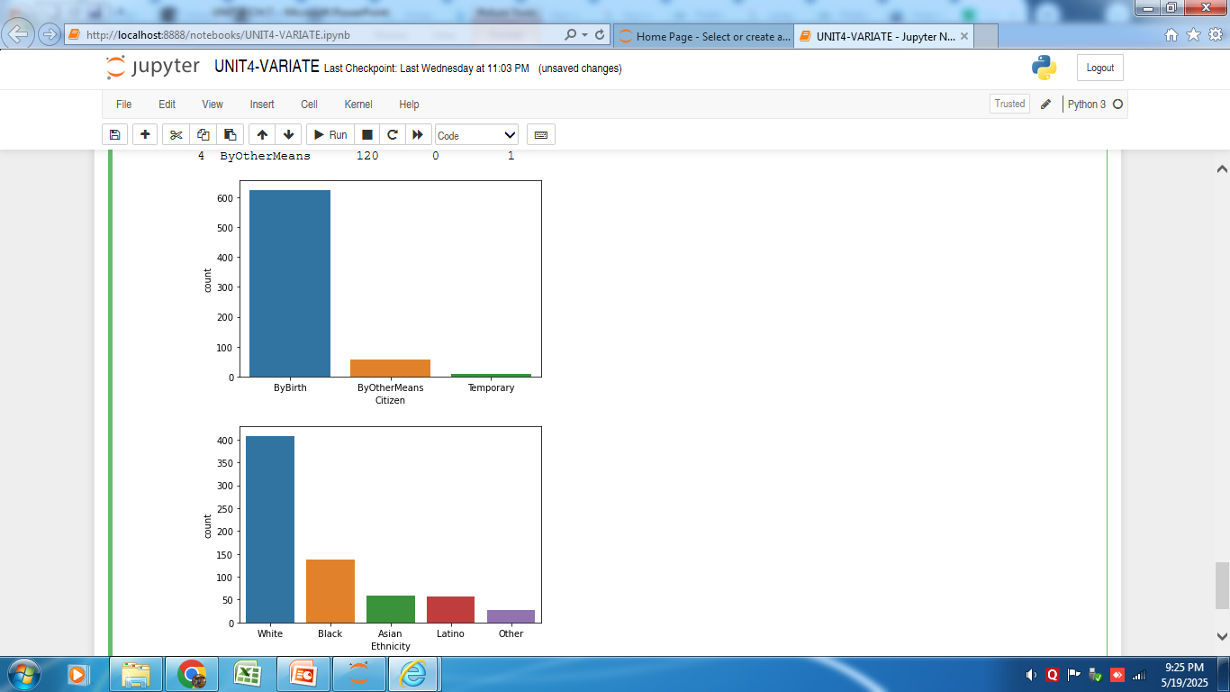
The trend in ethnicity might be due to the region the data was collected from.

Slide 32
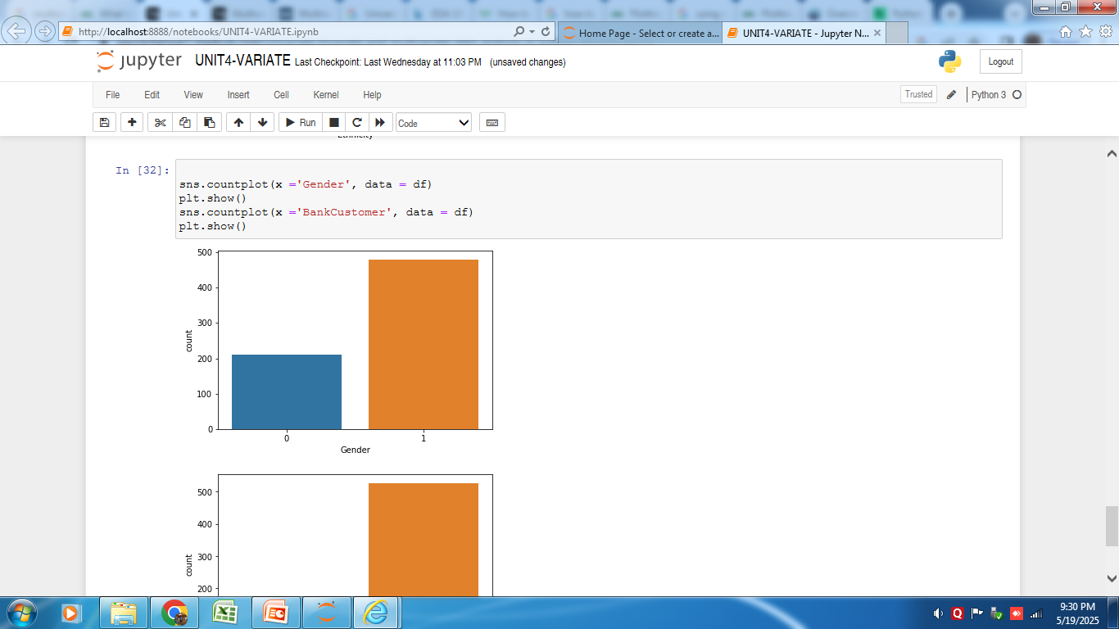
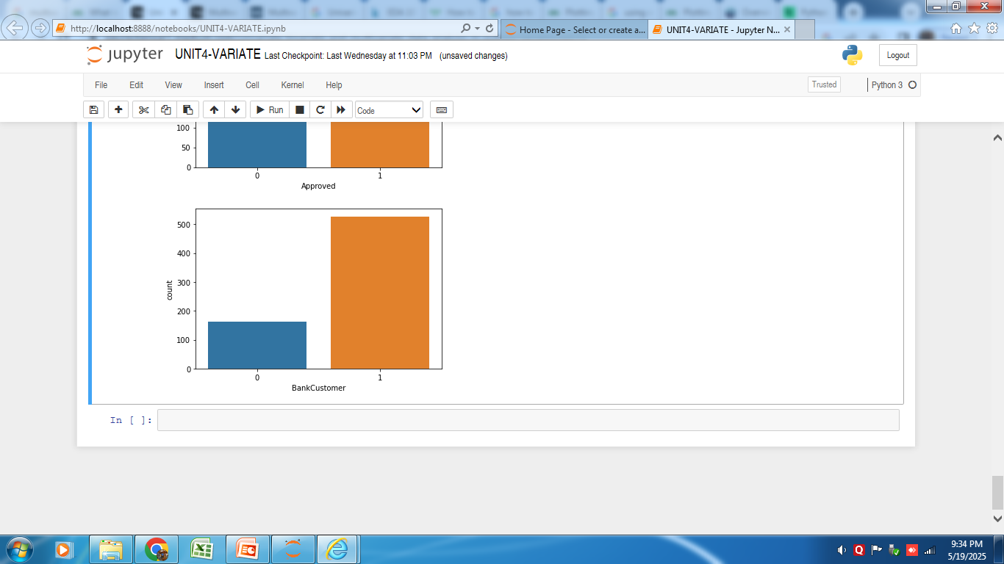
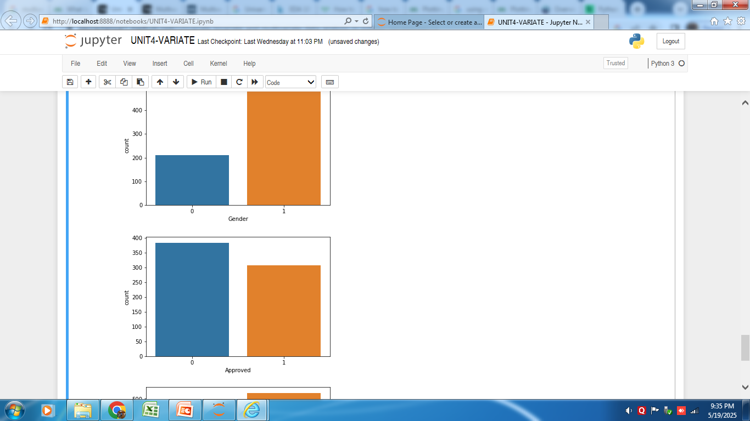
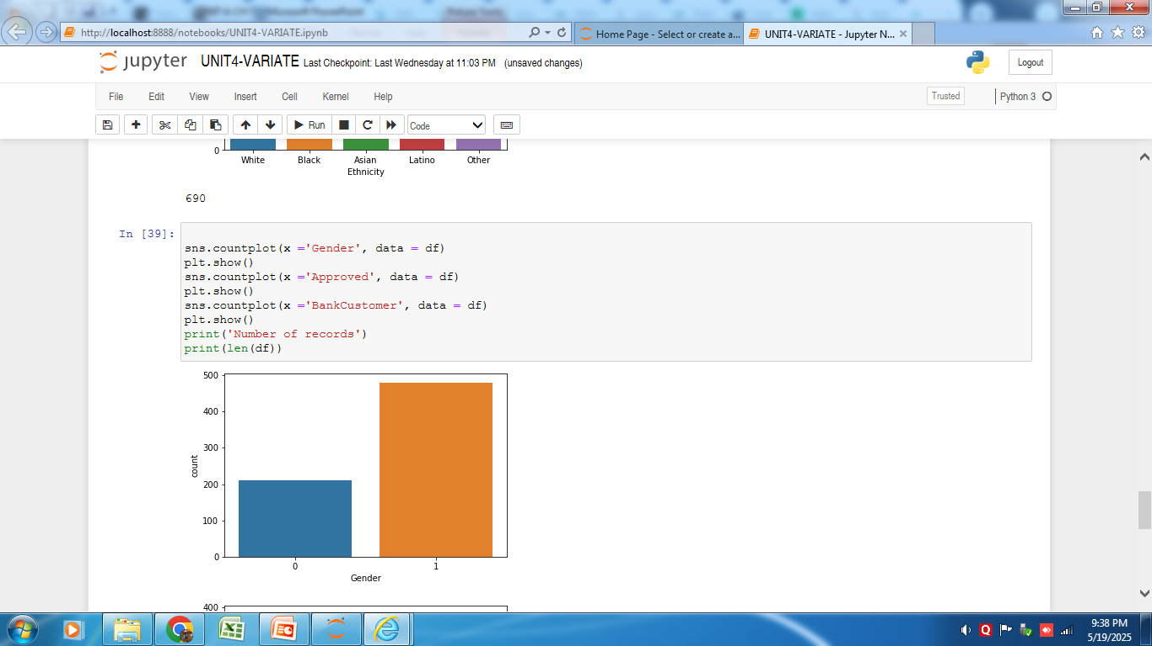
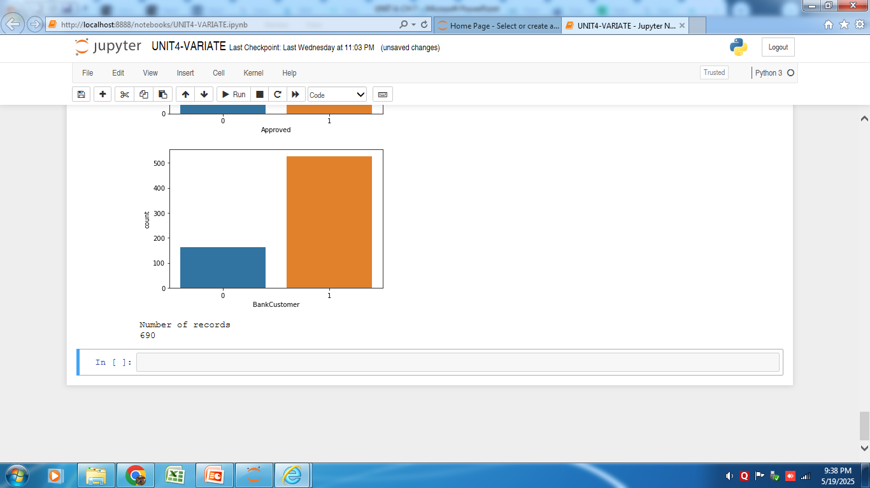

Slide 33
Observations:
Males (Gender -1 ) applied more than women (Gender -0) did.
People having bank accounts applied more than people who don’t have bank accounts. This cause no surprise.
The majority of applications were rejected, i.e., less than 50% of the applications were approved.

Slide 34
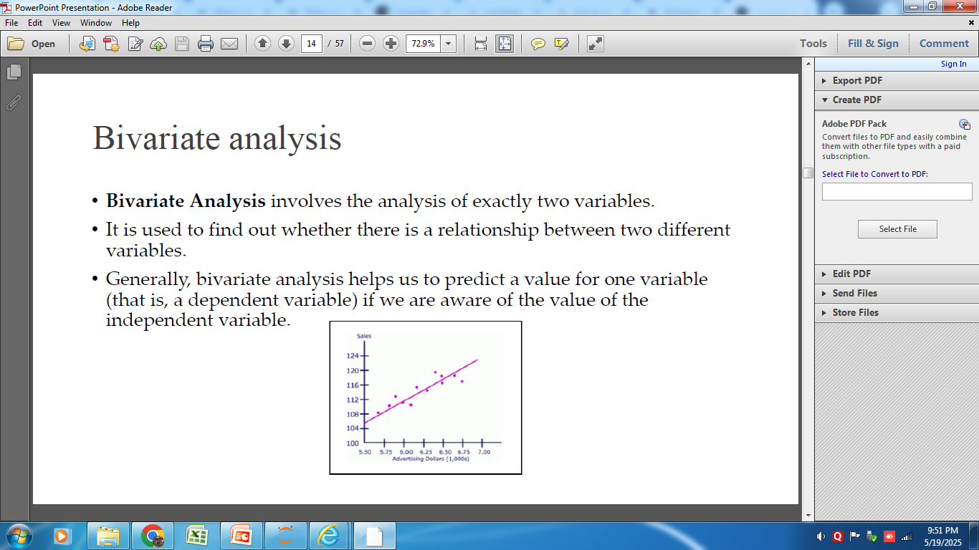

Slide 35



